Slide 1
Deep learning workshop
By ramanandan nk , ajay bhat

Slide 2
Workshop structure
Intro to deep learning
Applications of Deep learning (Style transfer , deep traffic )
Regression
Error Handling while modeling
Gradient Decent

Slide 3
Workshop structure
Introduction To Neural Networks In depth Analysis
Coding Neural Networks From Scratch
Predicting Bike Deployment Trend
Sentimental Analysis of Movie Reviews using neural network

Slide 4
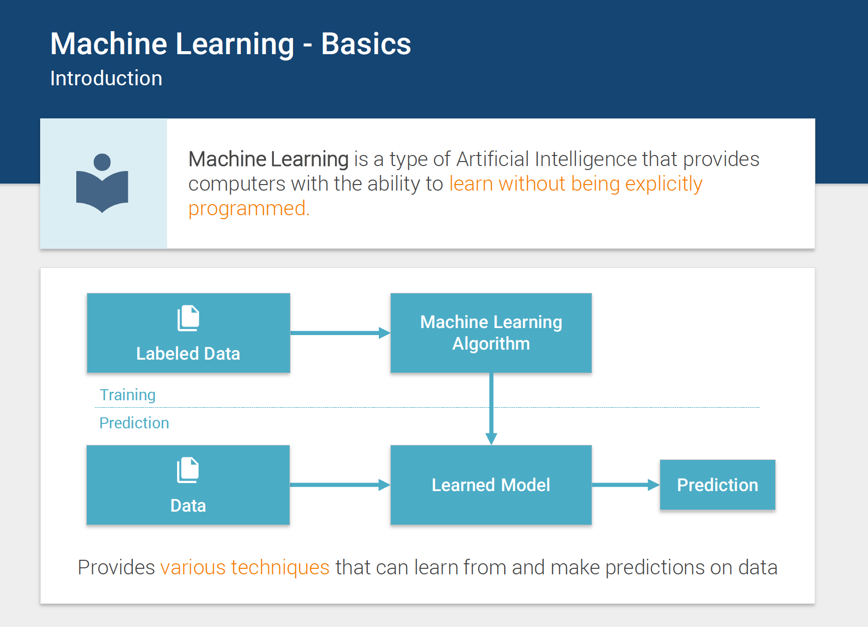

Slide 5
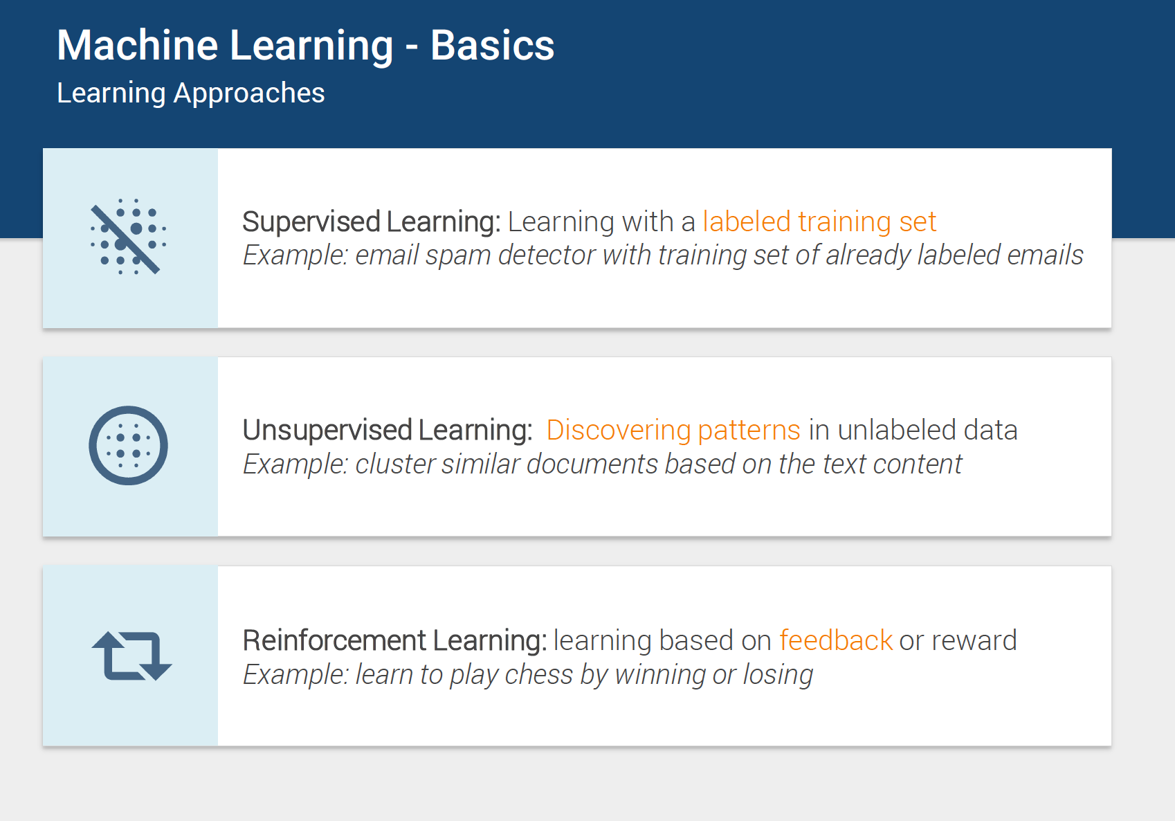
Notes:
Chess bot

Slide 6
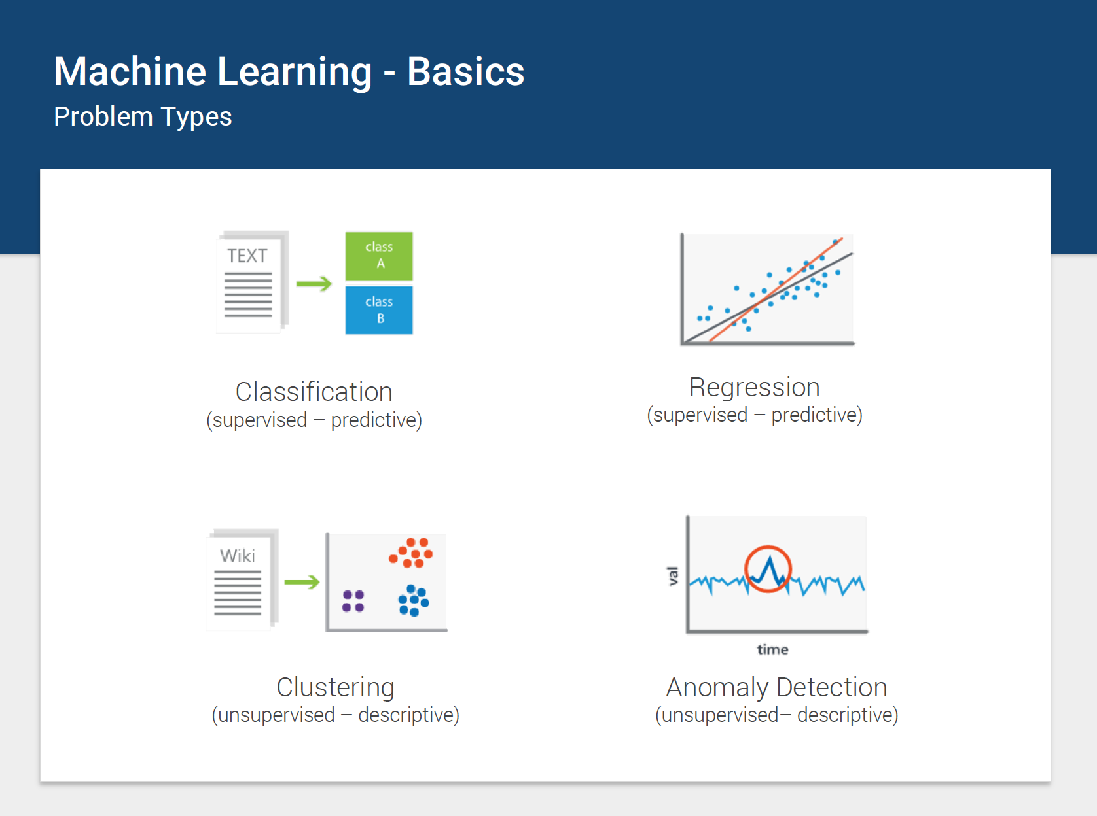

Slide 7
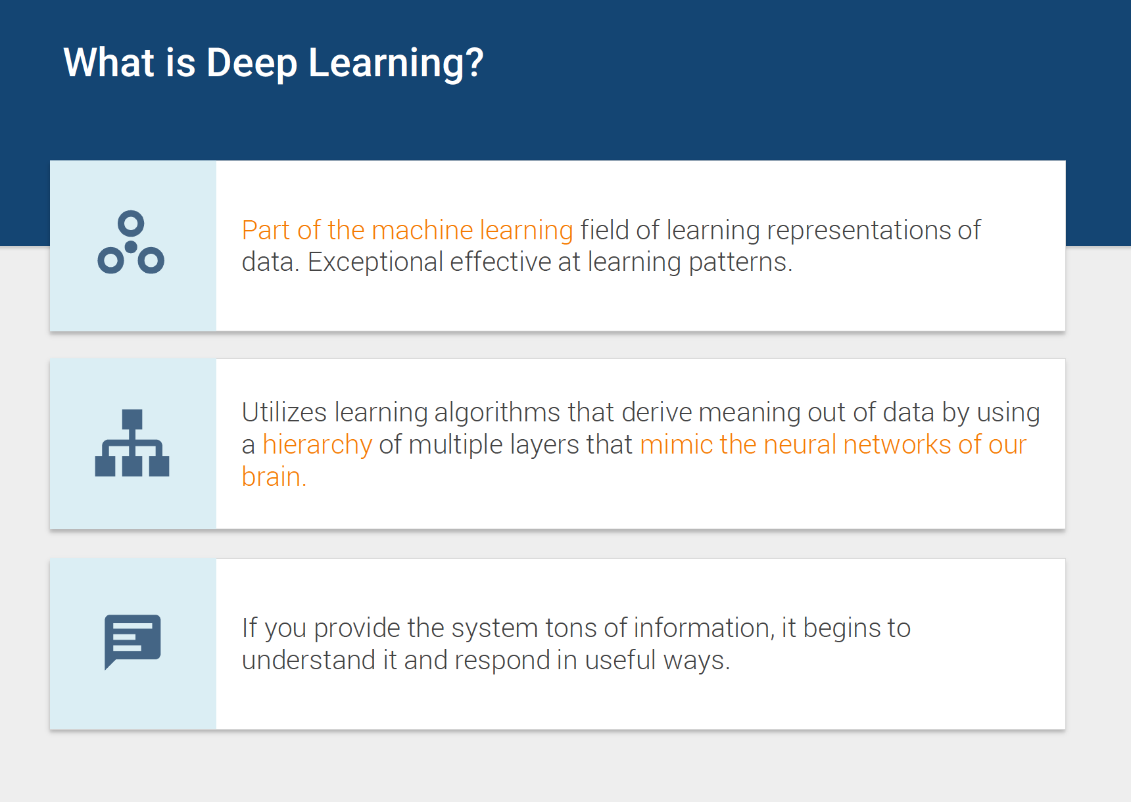

Slide 8
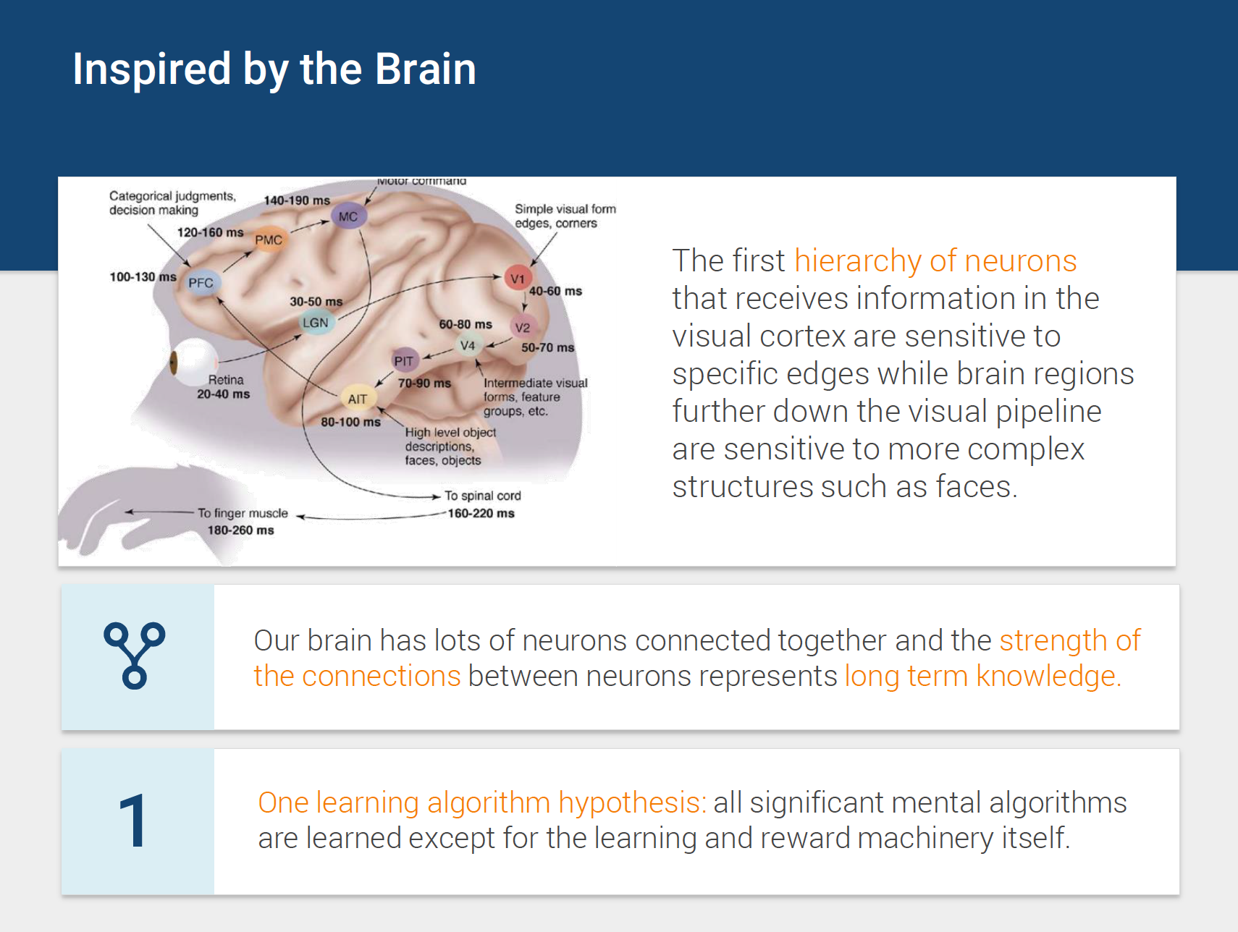

Slide 9
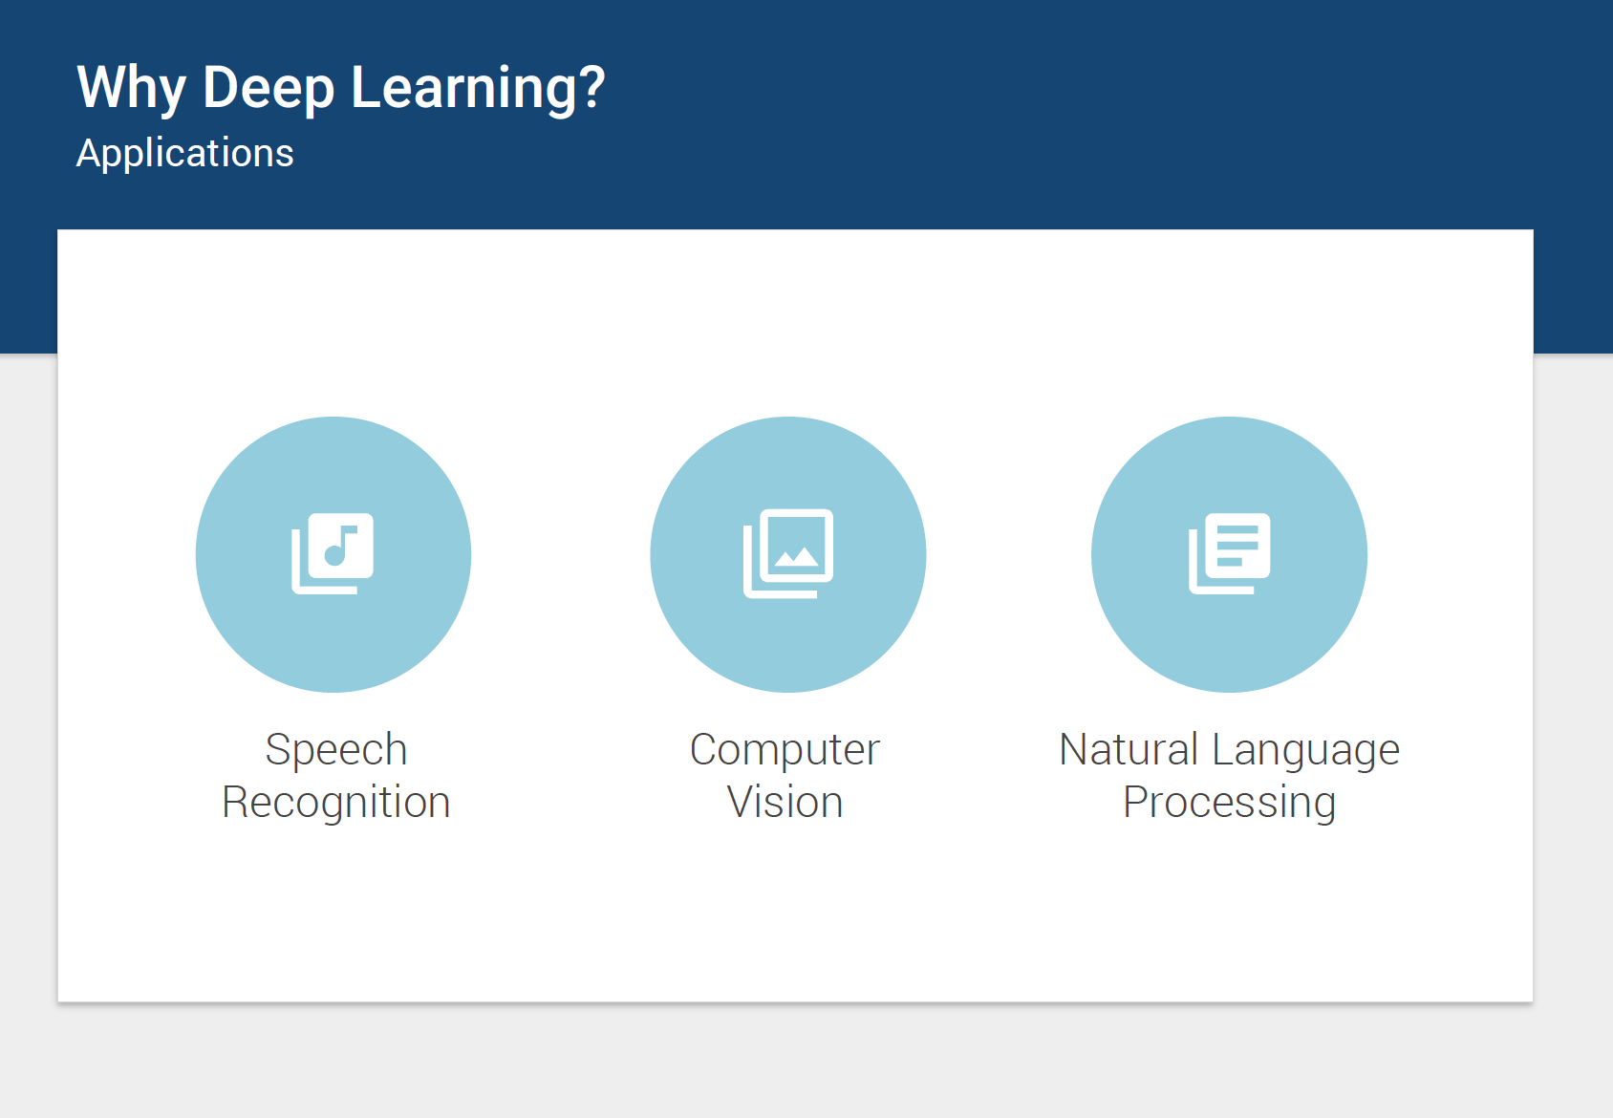

Slide 10
APPLYING DEEP LEARNING
STYLE Transfer
DEEP TRAFfIC

Slide 11

STYLE TRANSFER

Slide 12
What is style transfer
Style transfer allows you to take famous paintings, and recreate your own images in their styles! The network learns the underlying techniques of those paintings and figures out how to apply them on its own.
In this exercise we’ll try out style transfer using a famous style transfer repository.

Slide 13
SETTING UP THE environment
conda create -n style-transfer python=3.5
activate style-transfer
conda install -c conda-forge tensorflow=0.12.1
conda install scipy pillow

Slide 14
INSTRUCTIONS
Download the Zip archive from the https://github.com/lengstrom/fast-style-transfer repository and extract it.
Download the Rain Princess checkpoint from there. Put it in the fast-style-transfer folder. A checkpoint file is a model that already has tuned parameters. By using this checkpoint file, we won't need to train the model and can get straight to applying it.
Copy the image you want to style into the fast-style-transfer folder.
Enter the Conda environment you created above, if you aren't still in it.
In your terminal, navigate to the fast-style-transfer folder and enter

Slide 15
Run on terminal
python evaluate.py --checkpoint ./rain-princess.ckpt --in-path <path_to_input_file> --out-path ./output_image.jpg

Slide 16
DEEP TRAFFIC
The network here is attempting to learn a driving strategy such that the car is moving as fast as possible using reinforcement learning. The network is rewarded when the car chooses actions that result in it moving fast. It's this feedback that allows the network to find a strategy of actions for optimal speed.

Slide 17
Linear Regression
Finding the line of best fit for the given set of points
Best used to represent the relationship between a dependent and an independent variable
Independent variable is called the predictor
When you have one predictor variable, the equation of the line is
y=mx+b
Note Book Walk through

Slide 18
Multiple Linear Regression
When you have one predictor variable, the equation of the line is y=mx+b
Adding a predictor variable to go to two predictor variables means that the predicting equation is: y = m1x1 +m2x2 +b
f you use n predictor variables, then the model can be represented by the equation y=m1x1+m2x2+m3x3+…..mNxN+b

Slide 19
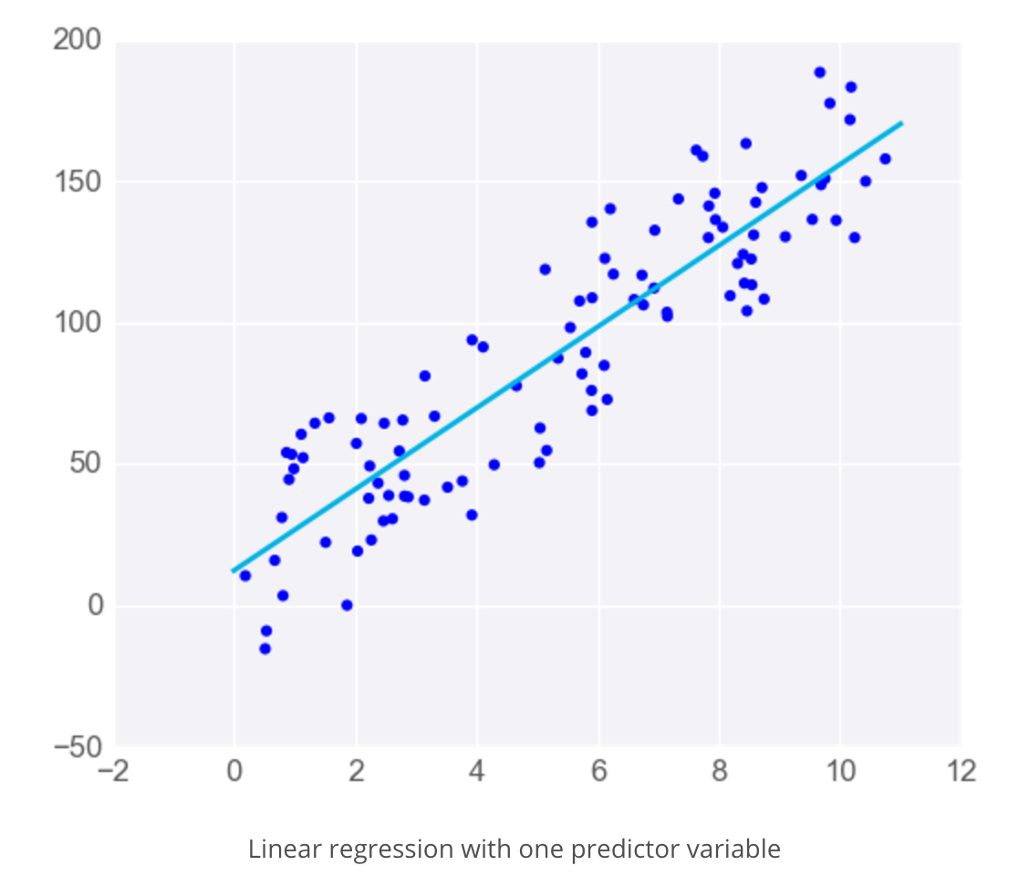
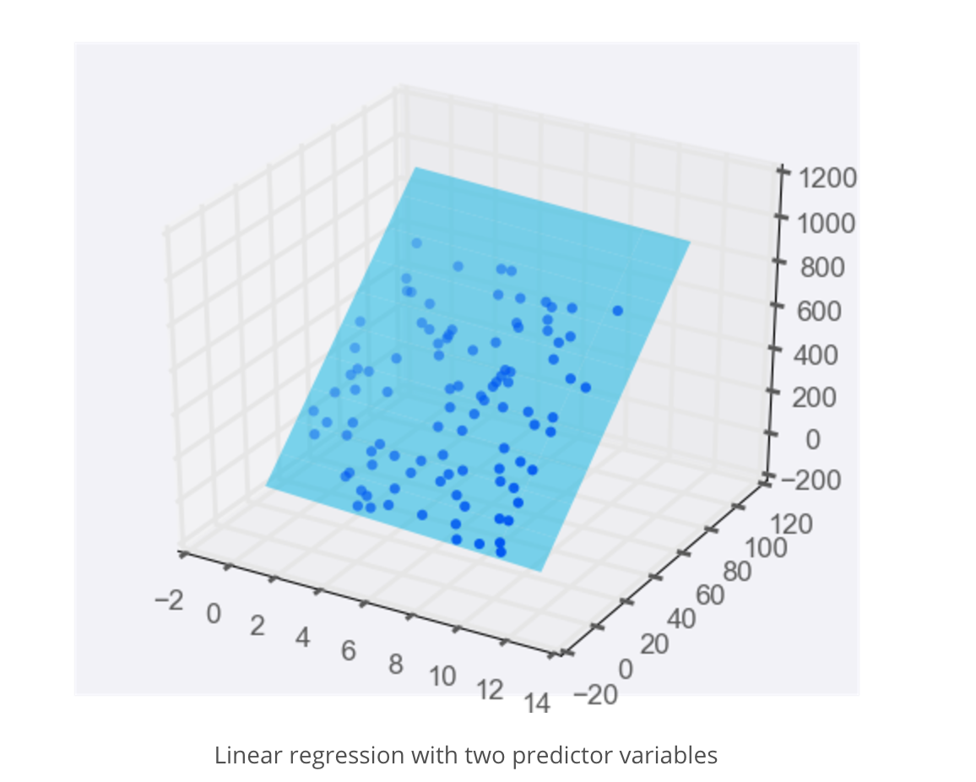
Visualization

Slide 20
Limitations of linear Regression
Linear regression comes with a set of implicit assumptions and is not the best model for every situation
Linear Regression Works Best When the Data is Linear
Linear Regression is Sensitive to Outliers

Slide 21
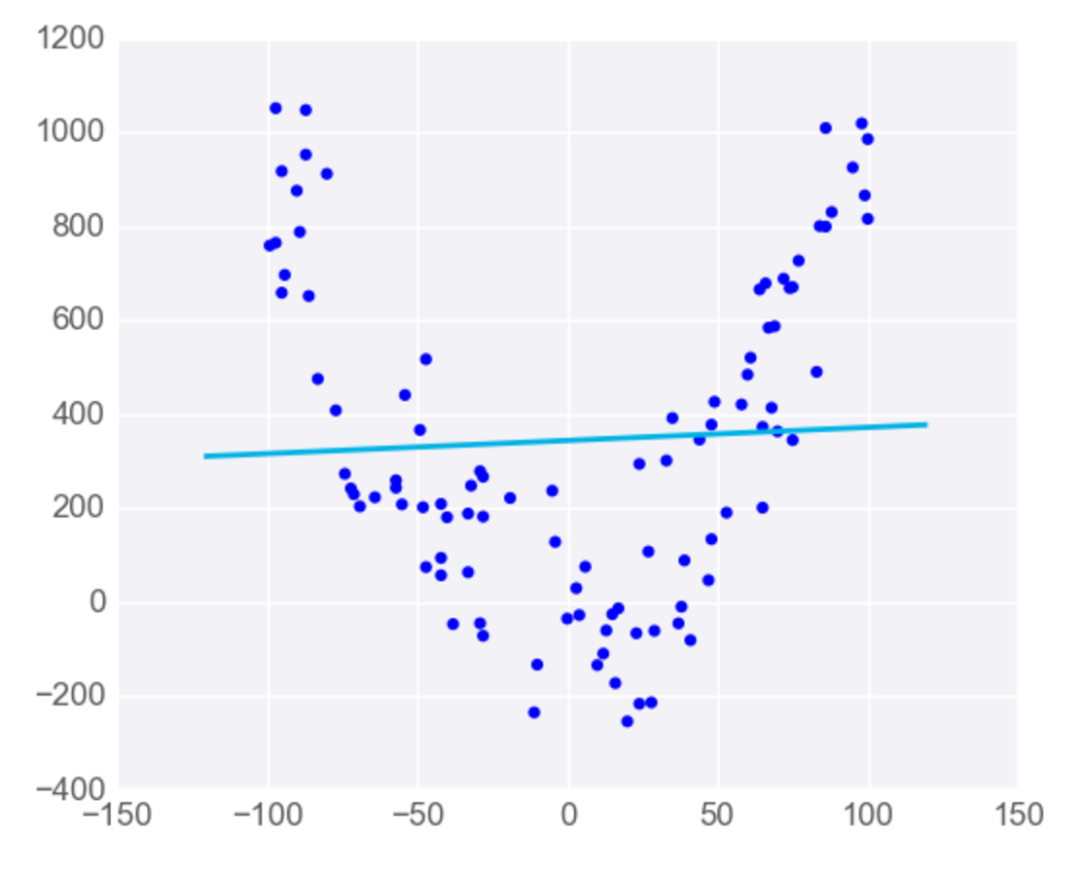
Linear Regression Works Best When the Data is Linear

Slide 22
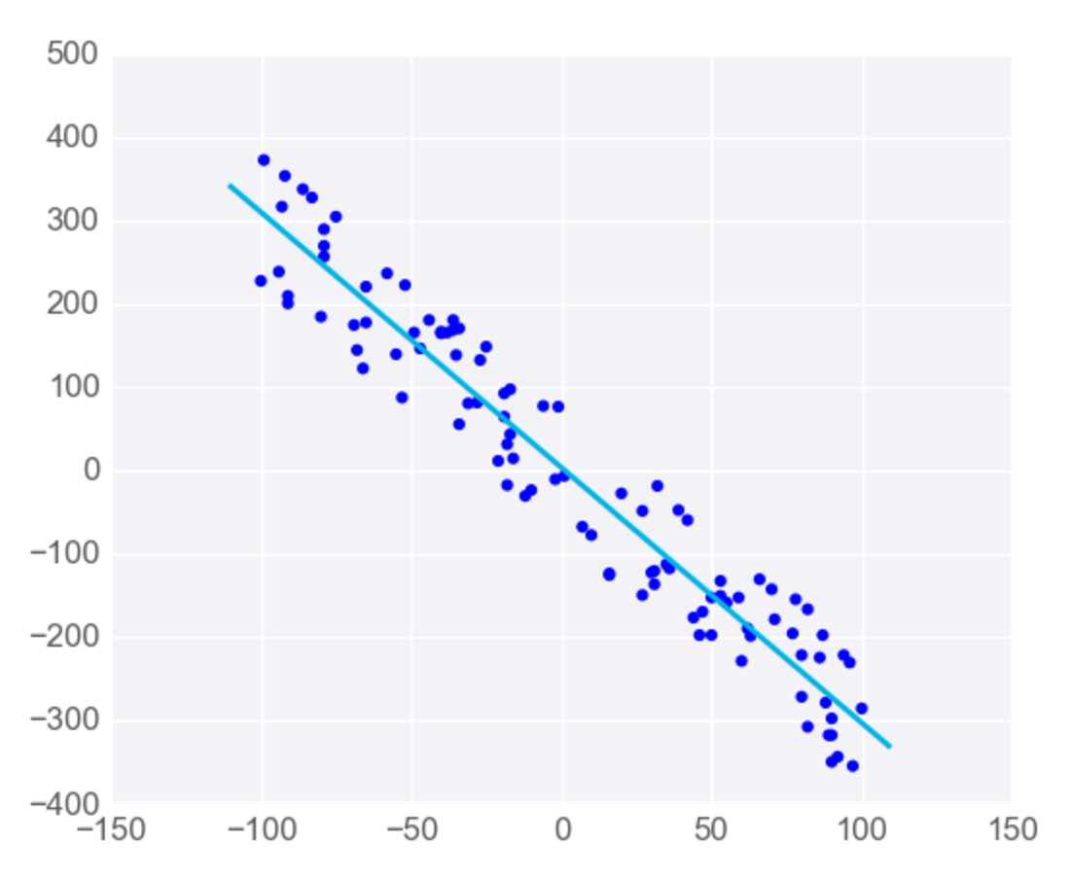
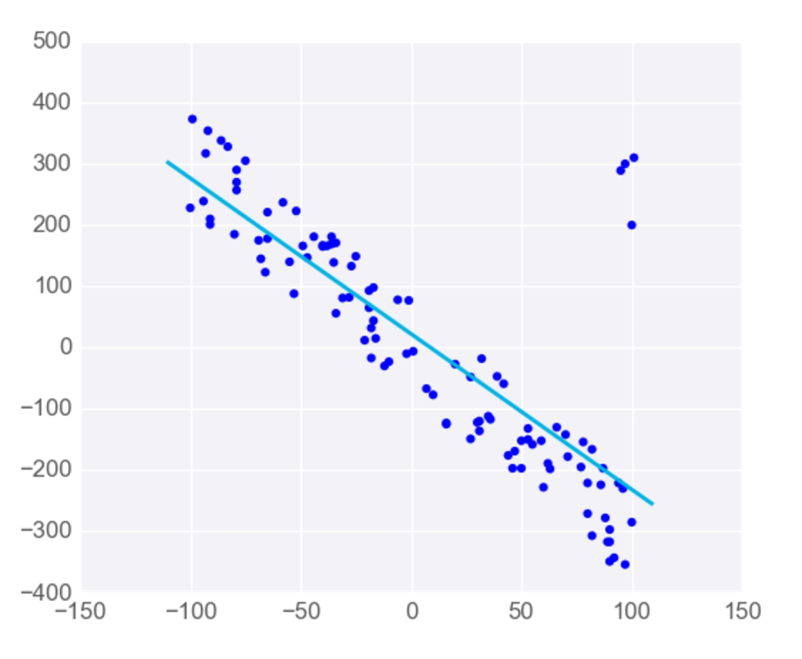
Linear Regression is Sensitive to Outliers

Slide 23
Regression metrics
MEAN ABSOLUTE ERROR
MEAN SQUARE ERROR
R2 SCORE

Slide 24
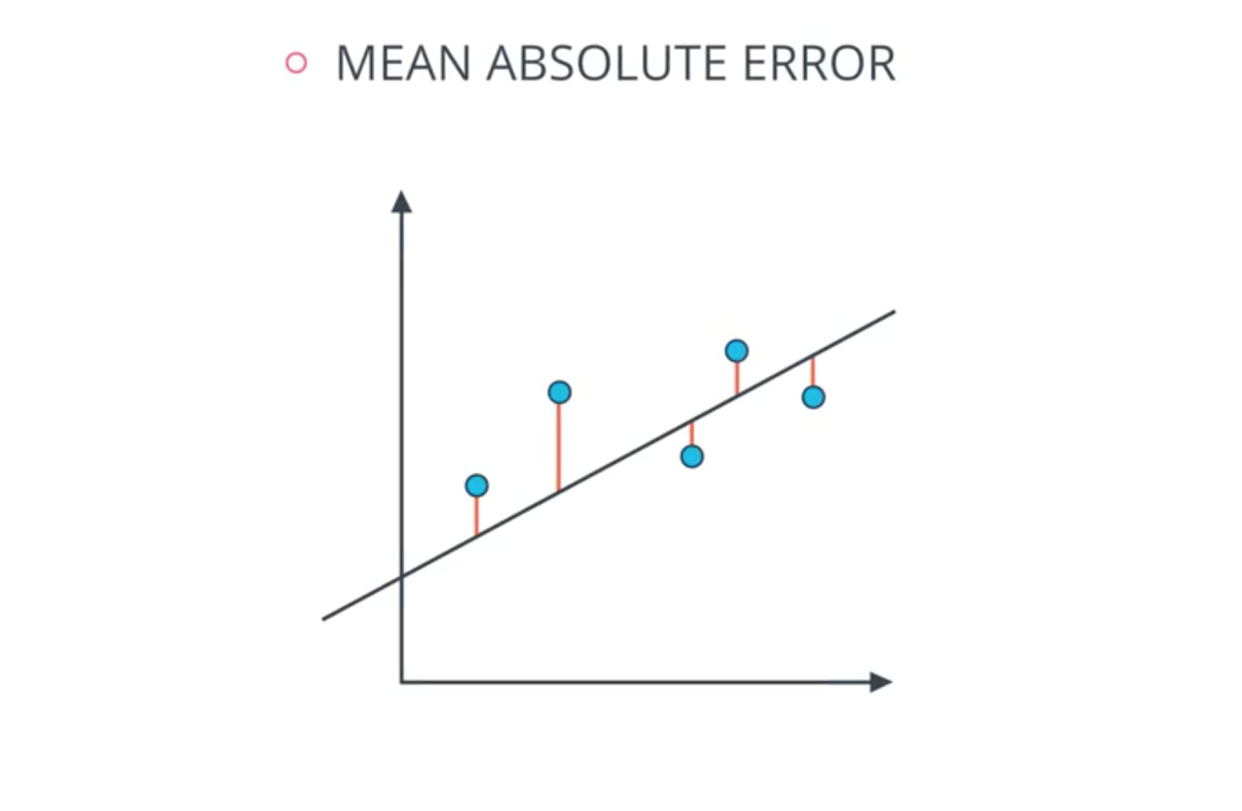

Slide 25
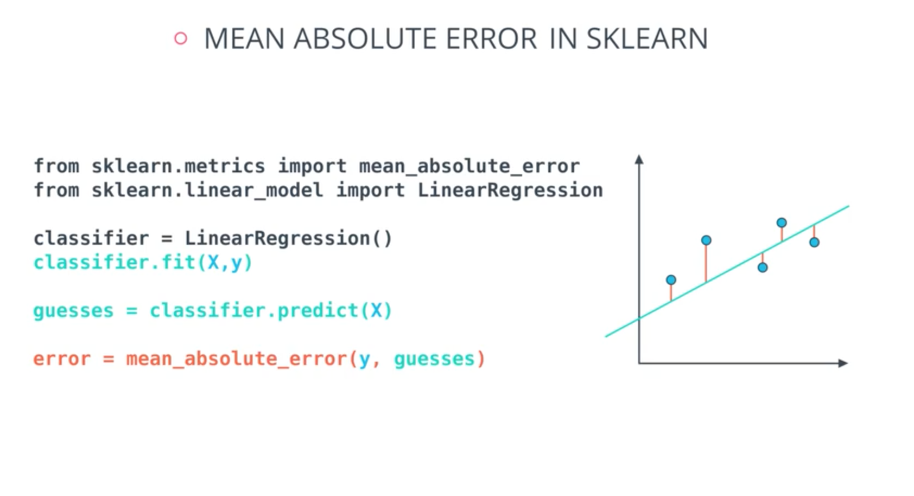

Slide 26
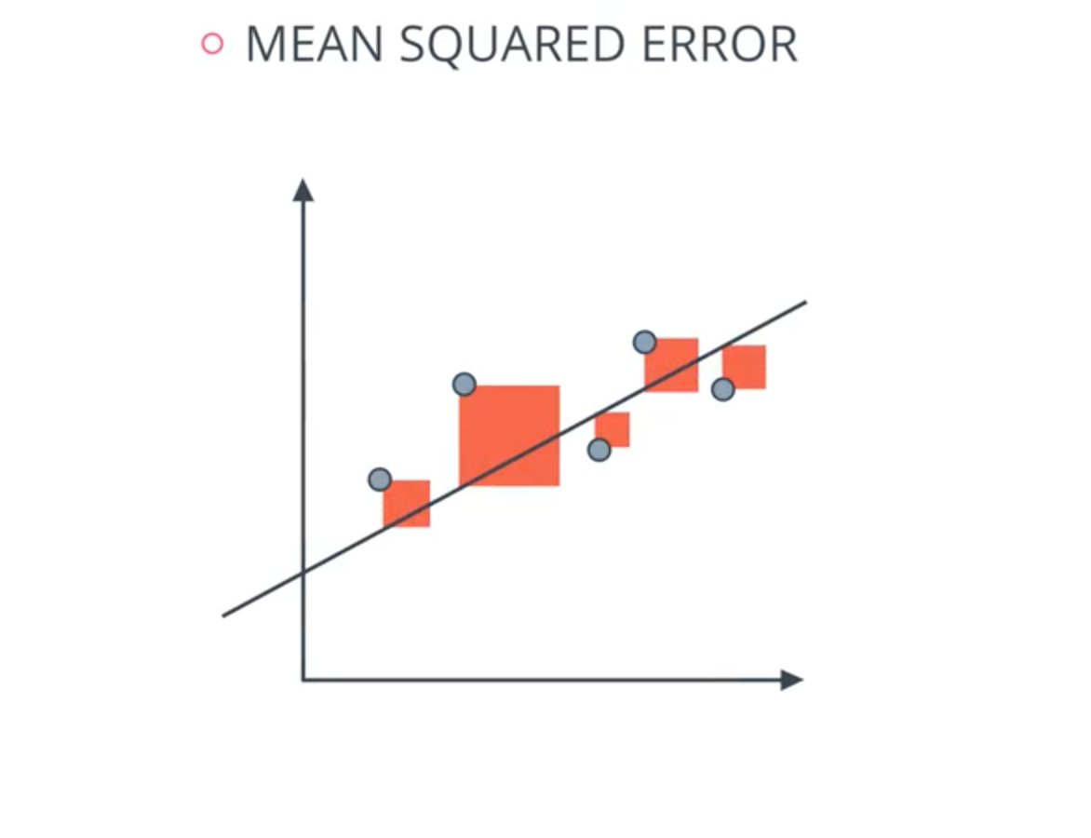

Slide 27
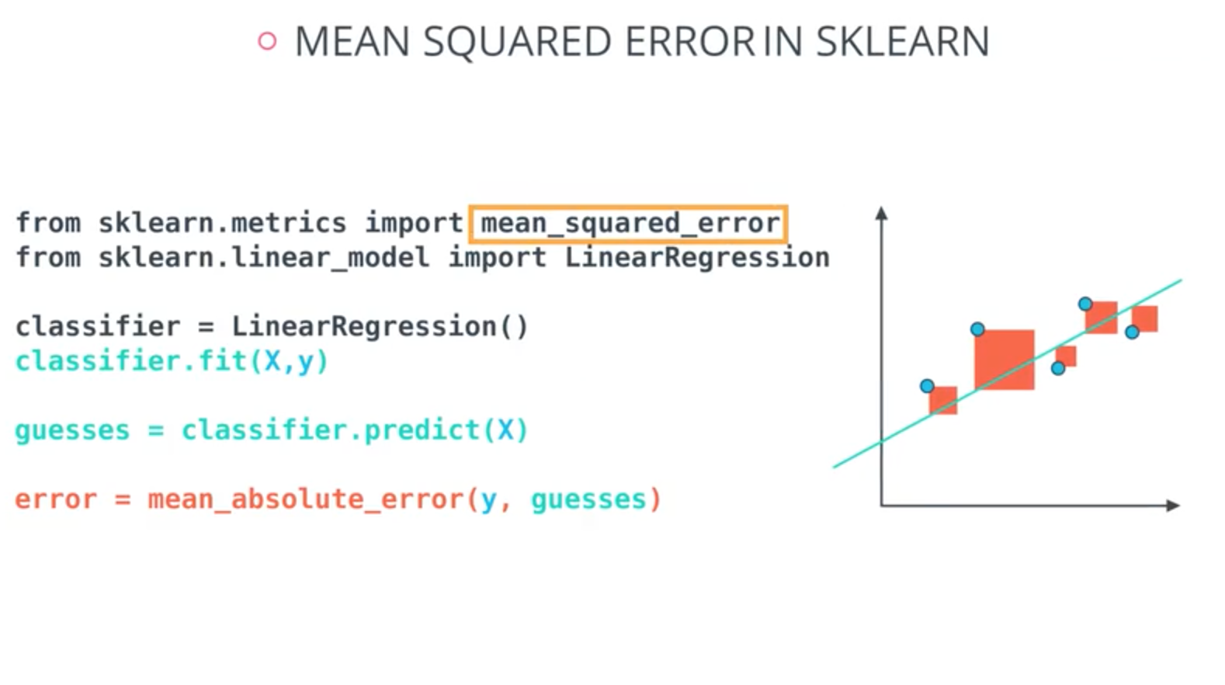

Slide 28
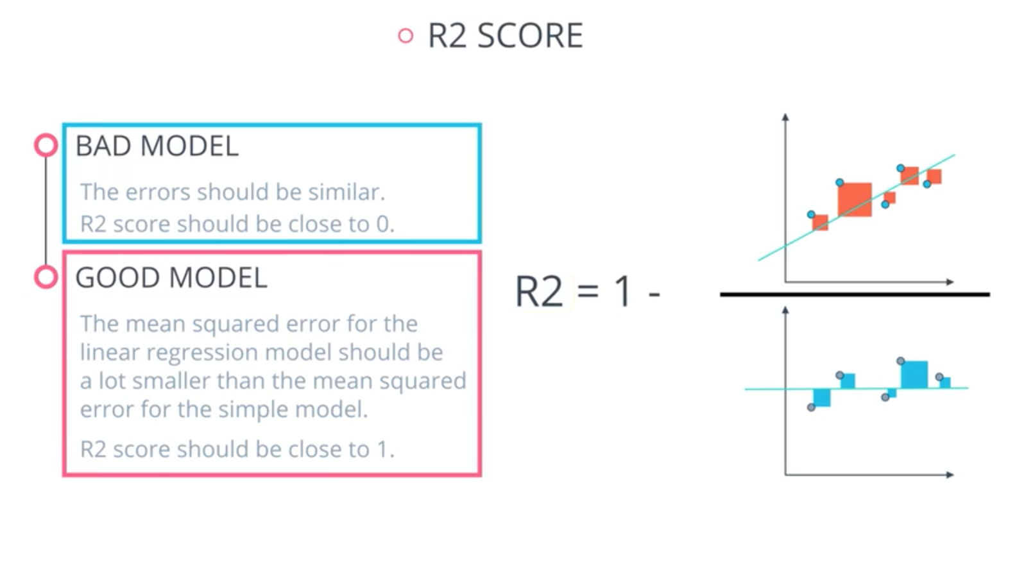

Slide 29
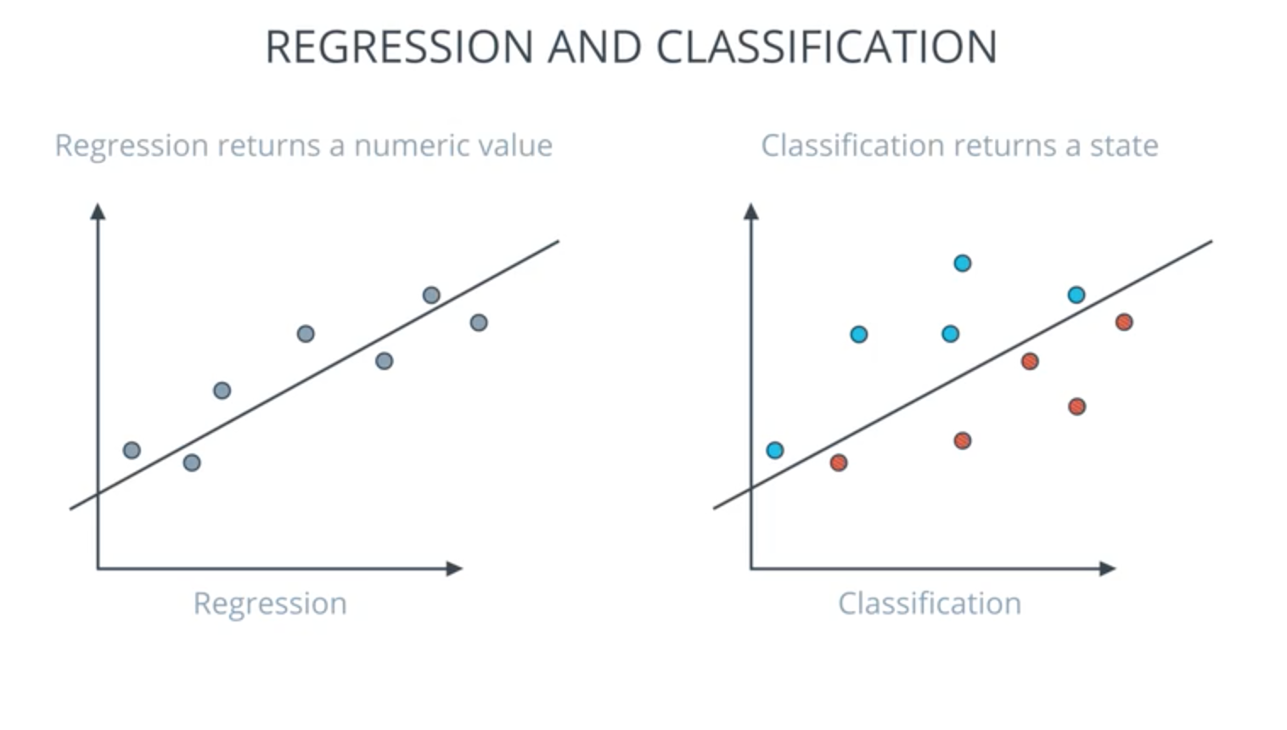

Slide 30
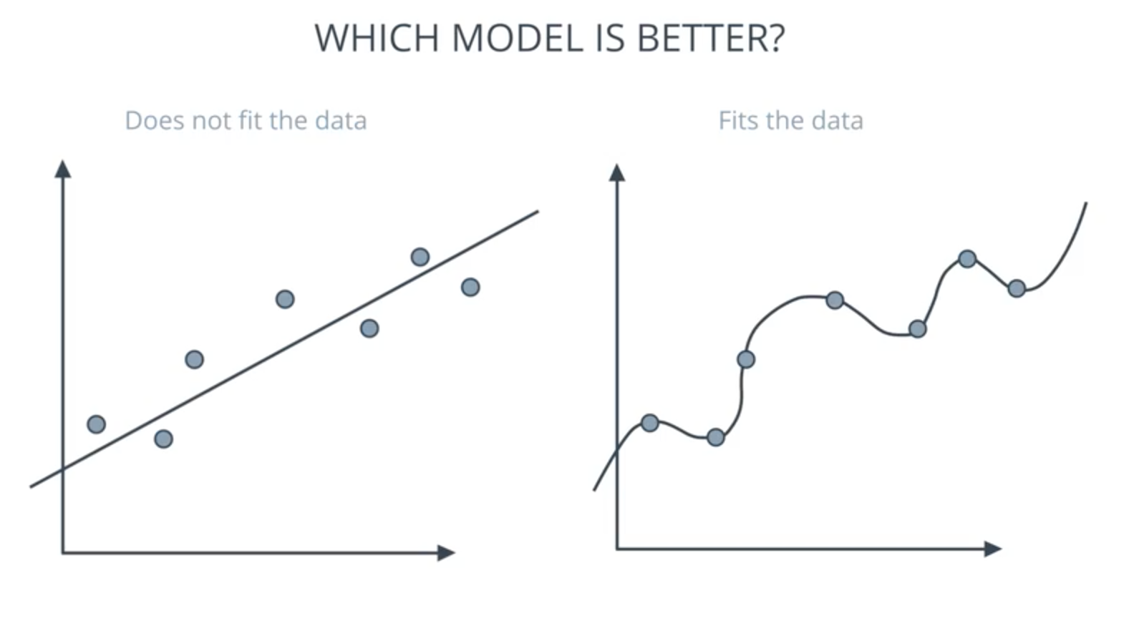

Slide 31
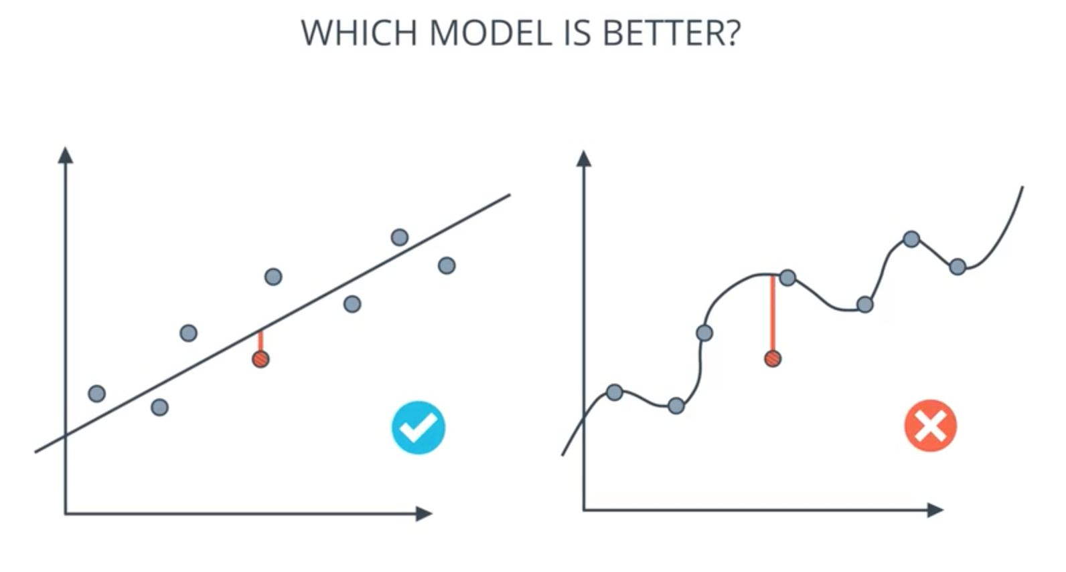
Notes:
RIGHT GEENERALISES MORES I MEAN APROXIMATES MORE

Slide 32
TYPES OF ERRORS
OVER SIMPLIFIYING THE PROBLEM
OVER COMPLICATING THE PROBLEM

Slide 33
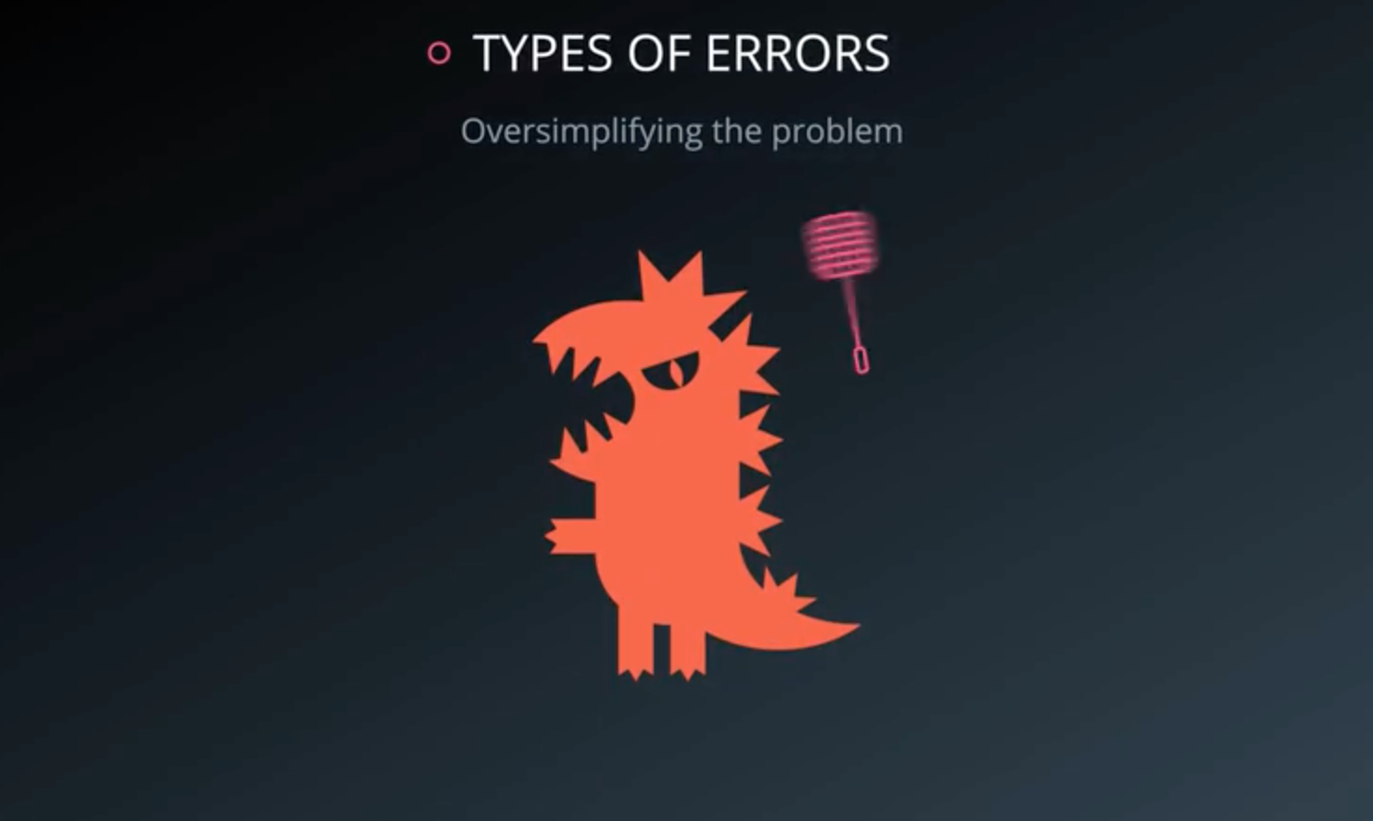

Slide 34
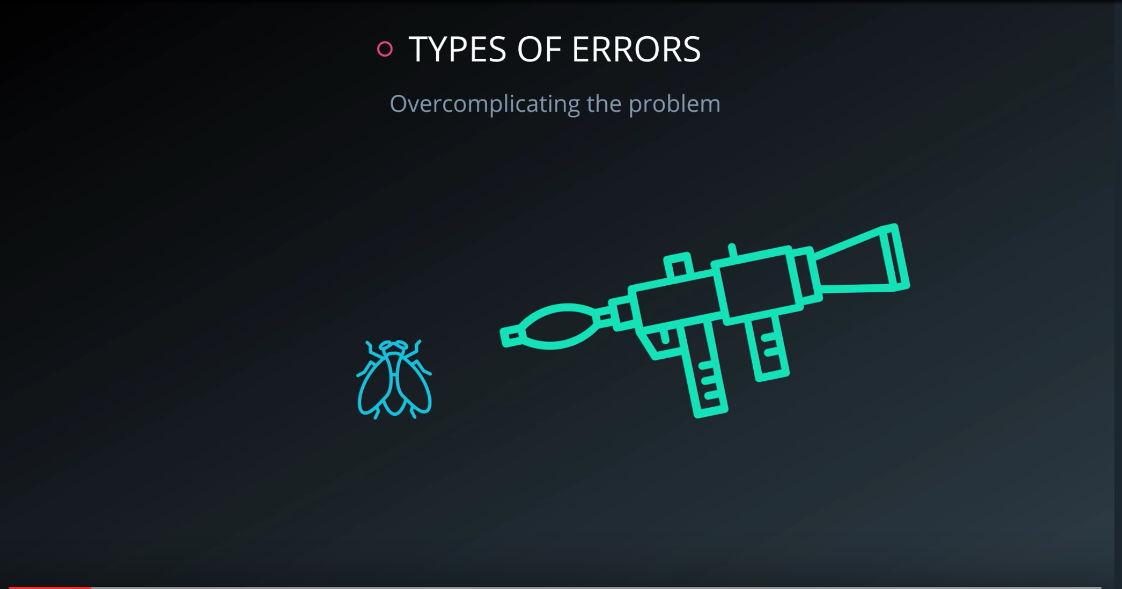

Slide 35
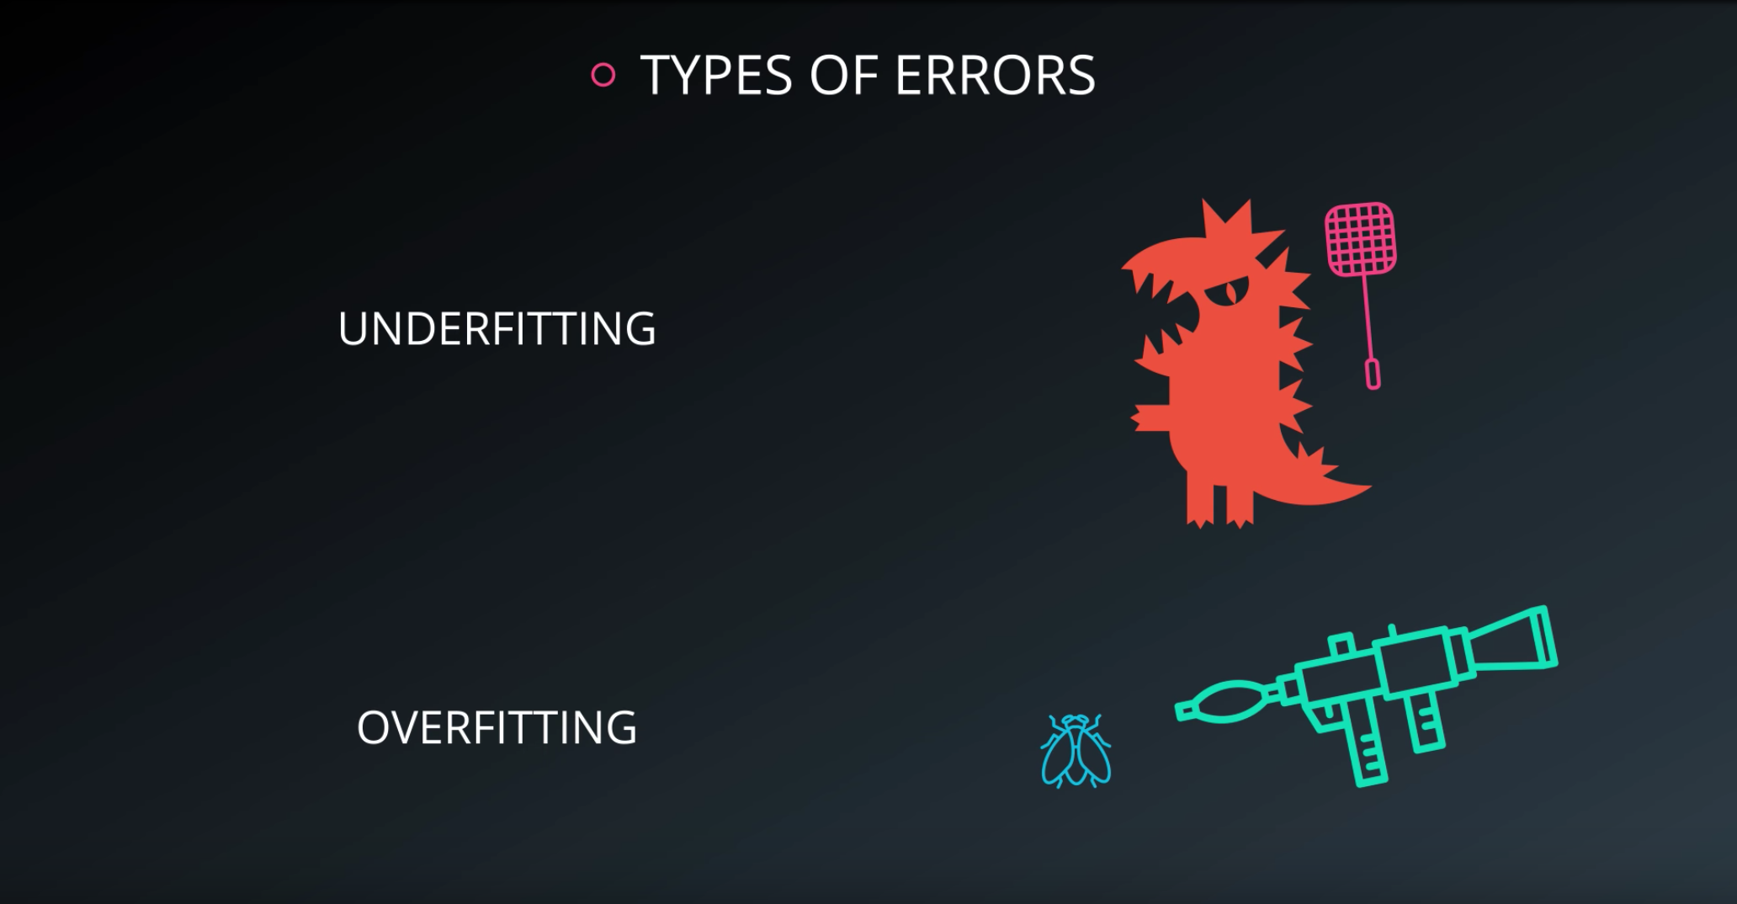

Slide 36
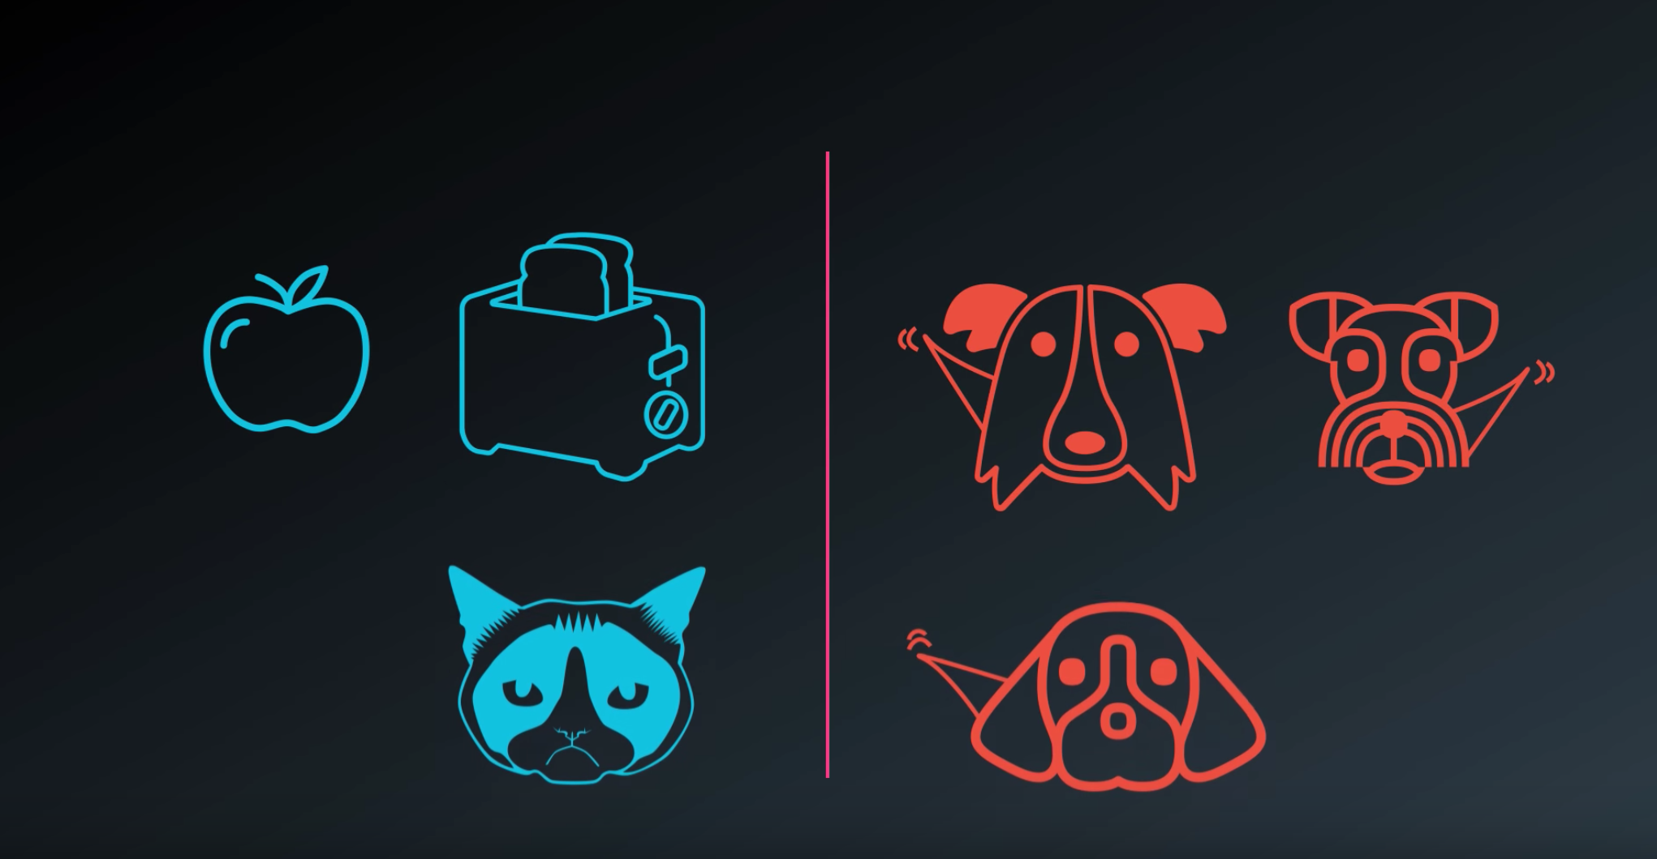

Slide 37
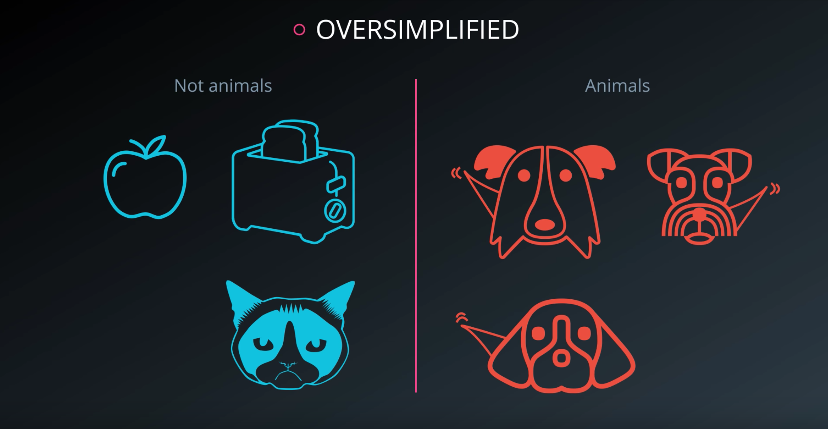

Slide 38
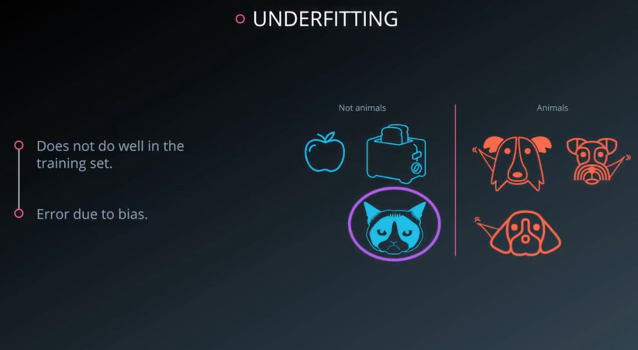

Slide 39
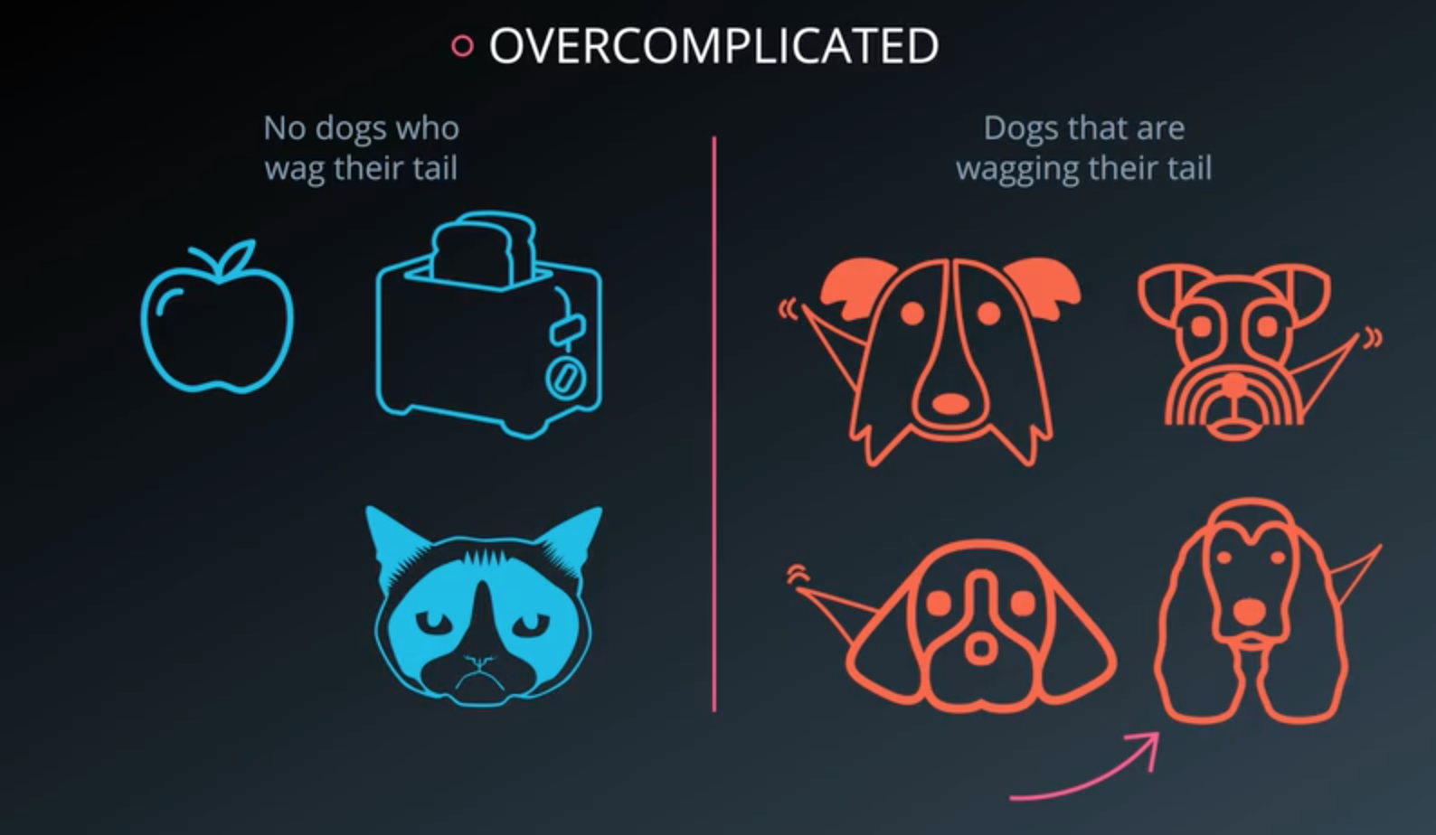

Slide 40
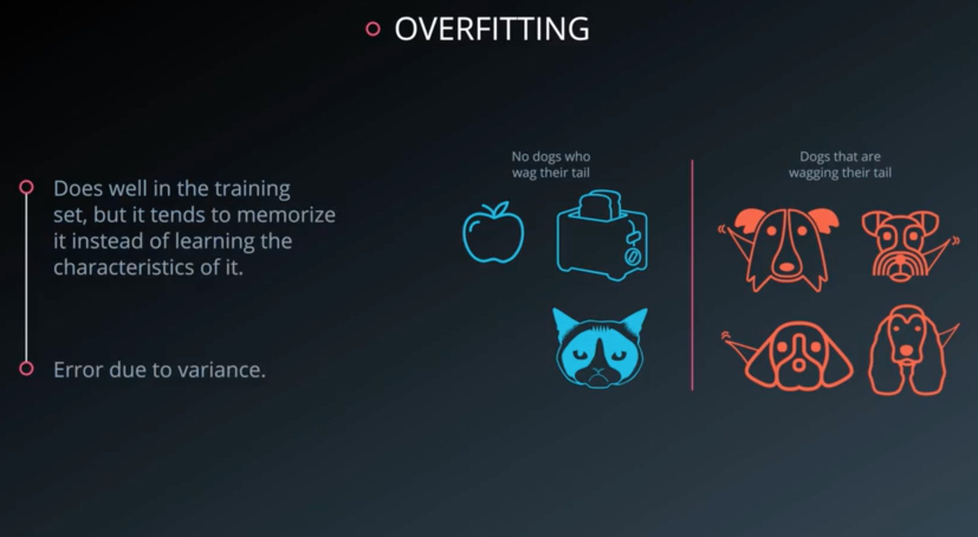

Slide 41
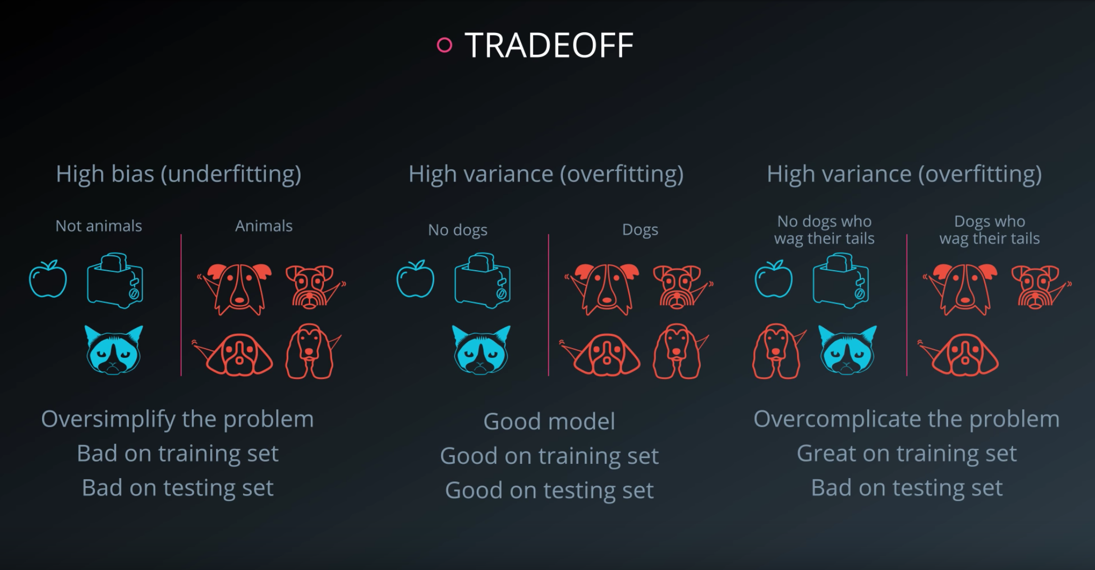

Slide 43
INTRODUCTION TO NEURAL NETWORK

